Slide 1
Sprint 1
Graphical Password Authenticator
Xucan Chen
SWE - Summer 2021
Team 1
Notes:
Tanj

Slide 2
Contents
Roles
Product Description
Motivation
Background
Problem statement
Approach
Risks
Functional & Non-Functional Requirements
Conceptual Model
Sprint1 Epics
Technical Requirements
Acknowledgements
Q&A
References

Slide 3
Introduction
Project Manager

Slide 4
Roles for Sprint #1
Name | Role | Assigned Task | Time Allocated
Archana BC | Project Manager | Project plan, Conceptual Model, Risk Assessment, Setup Github, Setup Discord Channel. | 2 weeks
Kevin Abrams | Developer | Prototype Development: Create Web app, Image grid authentication, Unit Testing. | 2 weeks
Saadh Ahmed | Scrum Master | Setup Zenhub, Epics , Burn down chart, Tech tools. Design presentation | 2 weeks
Saad Mahmood | Developer | Prototype Development | 2 weeks

Slide 5
What is our product?
Graphical Password Authenticator
Users enter a username and select from a group of images in a specific order

Slide 6
Motivation
Online Business market
Not a widely used concept - unsaturated market
User authentication
Security
More robust and safer from bot attacks
Novelty factor

Slide 7
Background
All online application users are subject to single or multi-level access authentication process to login.
Password based Authentication
Multi-factor Authentication
Biometric Authentication

Slide 8
Problem Statement
To Provide a simple and secure login authentication
Approach
Why go for Graphical password Authentication?
High Security
Protect against dictionary and brute force attacks
User friendly

Slide 9
Risks
Project Manager

Slide 10
Risks
Mitigation
Technology Risk [high]
Project & Product Risk [low]
Time Management [low]
Organizational Restructuring [moderate]
Biweekly stand up calls.
Post & discuss the issues
Role Handover
Incremental Development

Slide 11
Functional & Non- Functional Requirements
User has to pass through below requirements for successful login into web application
Functional:
Authentication
Authorization levels
Non-functional:
Usability
Security
Scalability

Slide 12
Models and Workflow
Project Manager

Slide 13
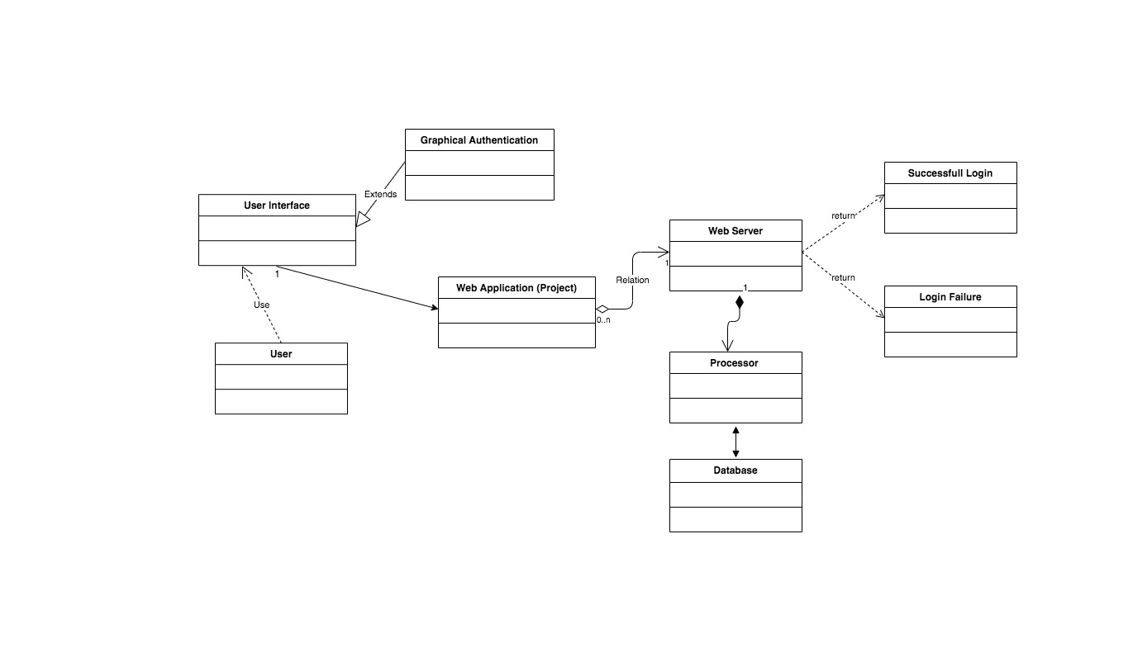
Architecture/Conceptual Model
Notes:
//https://app.diagrams.net/?client=1#G1-Bdp5v9YB0Ao0yb26C889vCWmLcr62Bq link to edit conceptual model

Slide 14

Flow Chart
User
Register
Login
Enter Username
Create Username
Enter Password
User Exists
Create Password
Password Auth
Success
Success
Failure

Slide 15
Burndown Chart and Epic Analysis
Scrum Master

Slide 16
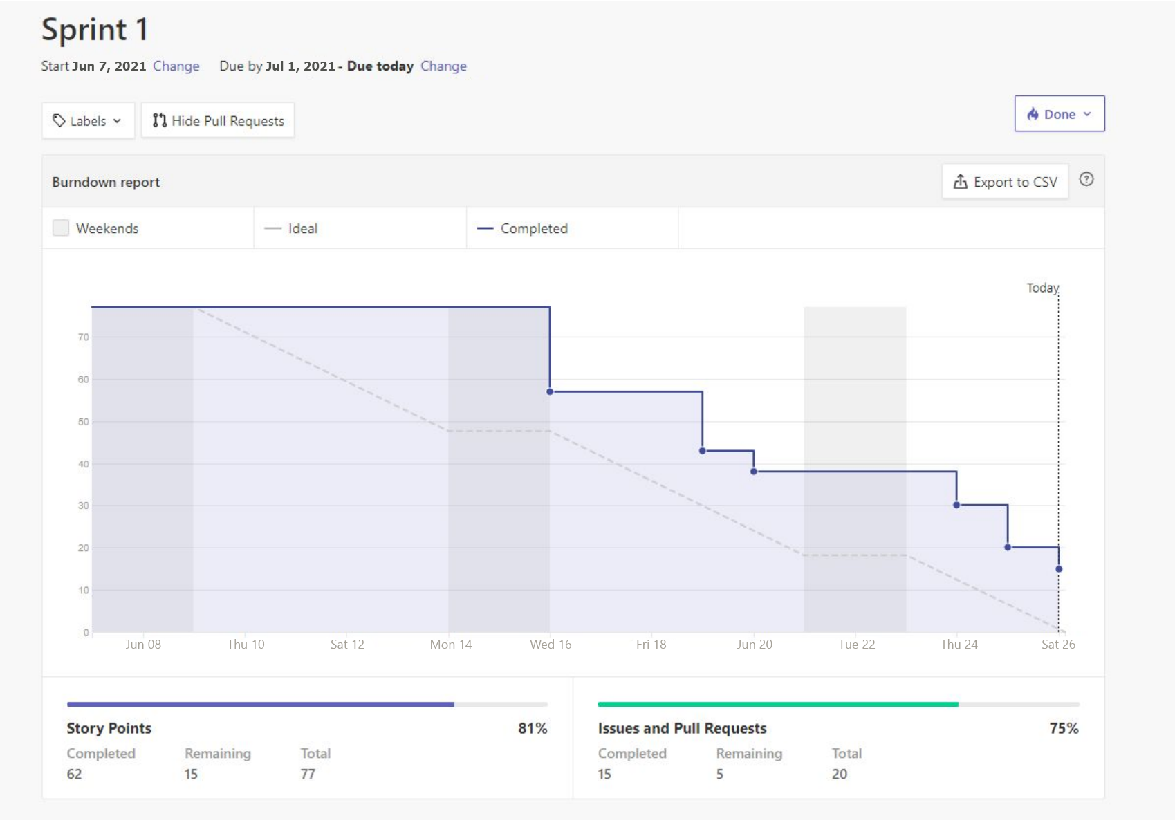

Slide 17
Burndown Chart Analysis
Because of some unfamiliarity with Zenhub, there were delays in assigning Epics and Stories - resulted in the chart not matching the ideal trend.
Some Epics were created mid-sprint, causing the chart to be blocky, rather than smooth.
Weight in this case was the chosen metric. This was determined based on how important and how much effort was required for a certain issue.

Slide 18
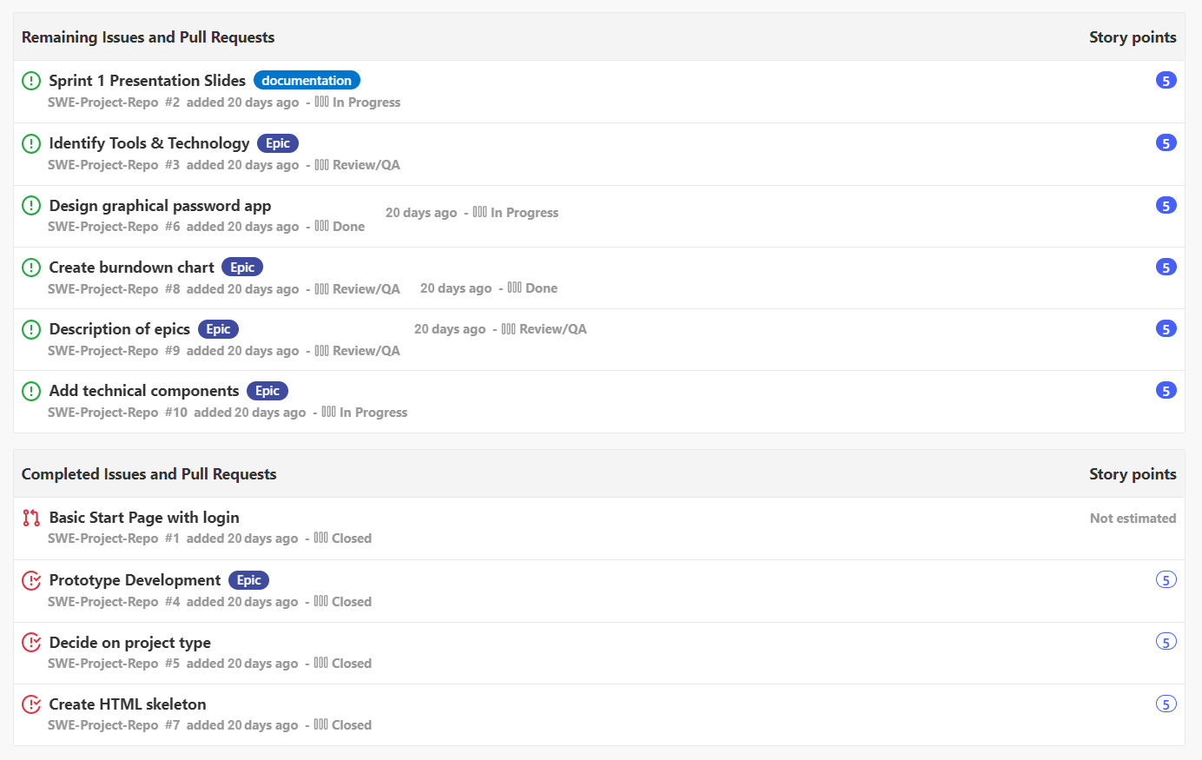
Notes:
Epic: Project Planning & Design
User Stories:
1. Requirement Gathering (Defining the Scope of the Project)
2. Identify the Technology & Tools Required for the Project Development
3. Planning, Work Assignment and Schedule of delivering the Project.
4. Design the Solution of a Project ( 5. Conceptual Model flow
6. Sprint Review and Retrospective

Slide 19
Identify Tool and Technologies
Prototype Development
Add Technical Components
Create Slides
Issues:
Determine Front End Tools
Determine Back End Tools
Determine Database System
Create Conceptual Model
Create User-side workflow
Issues:
Create user login page
Create Graphical Password Interface
Store username and password
Enable basic authentication w/o Firebase
Issues:
Create Github Repo
All team members must download critical dependencies
Firebase project creation
Setup work environment
Issues:
PM handles models, risks, background
SM handles charting and technical details

Slide 20
Technical Components
Scrum Master

Slide 21
Front End
HTML
Serves as our front-end skeleton. Has UI to obtain information from the user
CSS
Used for styling to make the app more visually appealing

Slide 22
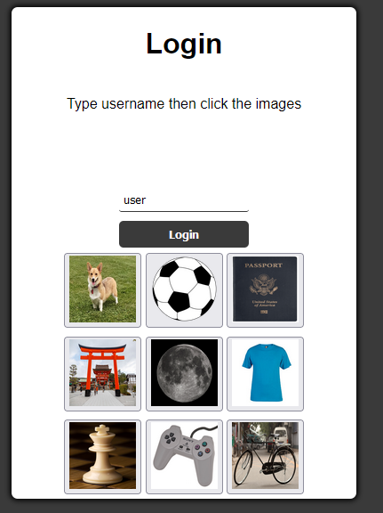

Slide 23
Back End
JavaScript
Js will be used to handle most of the website logic
Ex: Tokenizing username and password, sending to Firebase for auth
Firebase Auth
Will be used to handle user authentication
Firestore
Will be used to store user variables

Slide 24
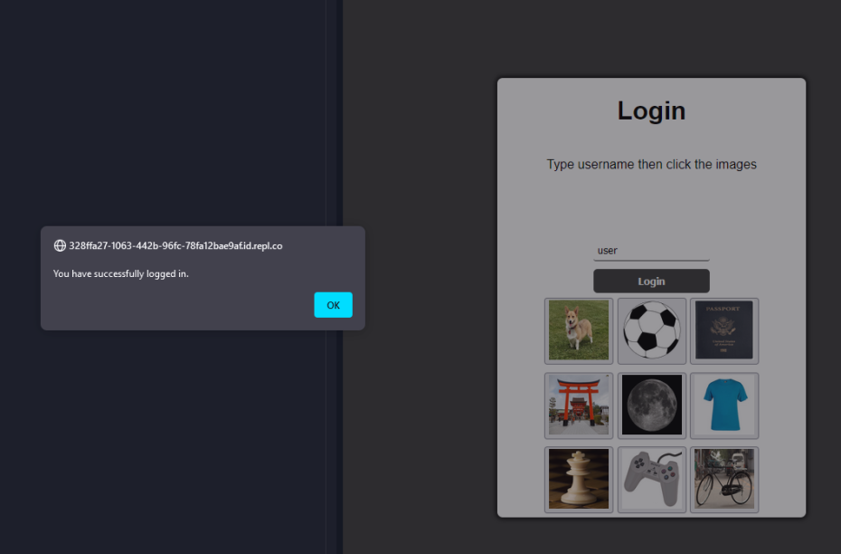

Slide 25
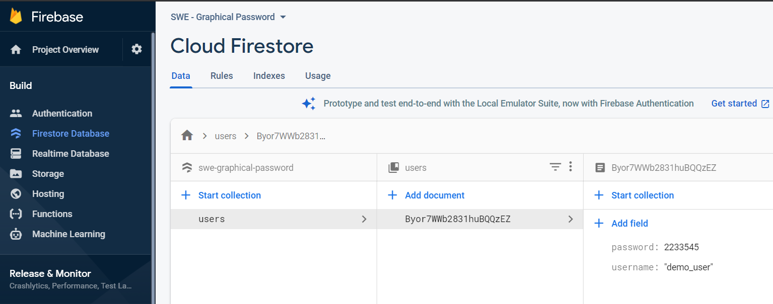

Slide 26
END
Q&A

